Slide 1
Grover’s Algorithm

Slide 2
The Problem
imagine we have access to an unstructured database, or list, containing N elements, each of which is represented by a unique n-bit string ID denoted x. The list can thus contain at most N = 2ⁿ elements. We are tasked with finding a particular "marked" element from the database with a particular bit-string x₀.

Slide 3
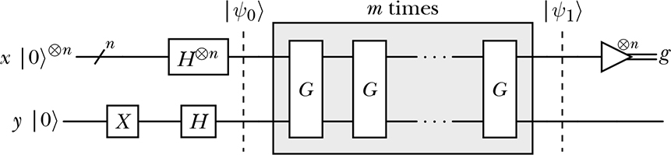
In a Nutshell: Grover Algorithm
The figure below is a typical circuit for Grover’s algorithm

Slide 4
The main steps
As the above diagram shows, the process starts with a register x of multiple (n) qubits all in the state |0⟩, and a register y containing a single qubit in the same state.
Then an X gate is applied to y, and all other n qubits are put into superpositions with H gates.
Next, we repeatedly apply an oracle operator followed by Diffusion operator

Slide 5
Main Steps
The main steps may be summarized as follows:
Start with a register on n qubits all in the |0> state
Apply a Hadamard gate to each of the n qubits
Repeat:
Apply an Oracle operator
Appy a diffusion operator
Measure all qubits

Slide 6
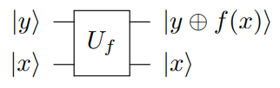
What are Quantum Oracles
Oracles are simply Boolean functions. We give an input to the function or oracle or black box, and it returns an output, without us knowing its inner workings.
Quantum oracles are black-box functions used in quantum computing to encode specific problems or functions, , into a unitary transformation. These oracles primarily serve to recognize solutions to a problem in a way that allows quantum algorithms to leverage quantum mechanics to efficiently search for the solution.
Quantum oracles play a key role in quantum algorithms, such as Shor’s and Grover’s algorithms.
The gate below is used to illustrate an oracle operation.

Slide 7
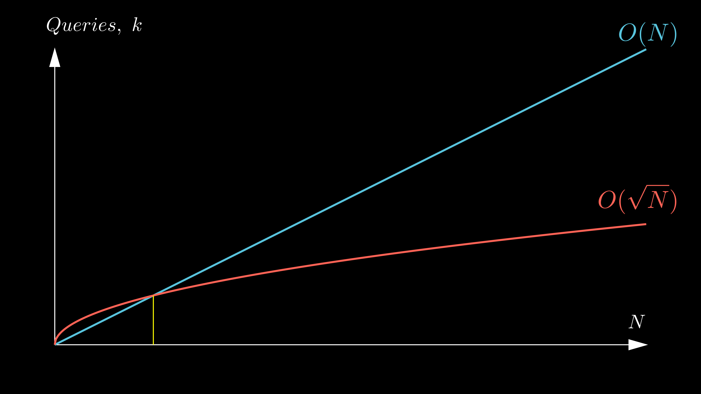
The Performance of the Algorithm

Slide 8
The Importance of the Oracle in Speedup
The oracle encapsulates the computational complexity of the problem into a quantum operation.
While it does not solve the problem directly, it bridges the problem definition and the quantum algorithm.
Its ability to efficiently encode and manipulate problem-specific information is the key reason Grover’s algorithm achieves its quadratic speedup over classical search methods.
Without the oracle, Grover's algorithm cannot function, making it an indispensable element of the quantum computational framework.

Slide 9
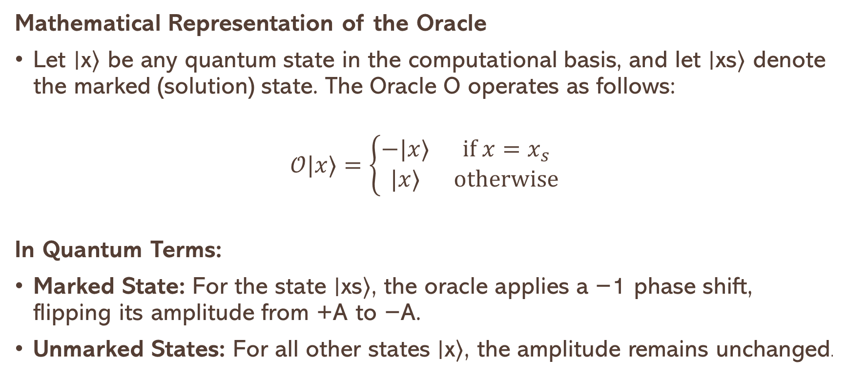
Oracle Operations
Mathematical Representation of the Oracle
Let ∣x⟩ be any quantum state in the computational basis, and let ∣xs​⟩ denote the marked (solution) state. The Oracle O operates as follows:
$$𝒪|x⟩=\left\{\begin{matrix}−|x⟩ & if x=x_{s} \\ |x⟩ & otherwise\end{matrix}\right.$$
In Quantum Terms:
Marked State: For the state ∣xs​⟩, the oracle applies a −1 phase shift, flipping its amplitude from +A to −A.
Unmarked States: For all other states ∣x⟩, the amplitude remains unchanged.

Slide 10
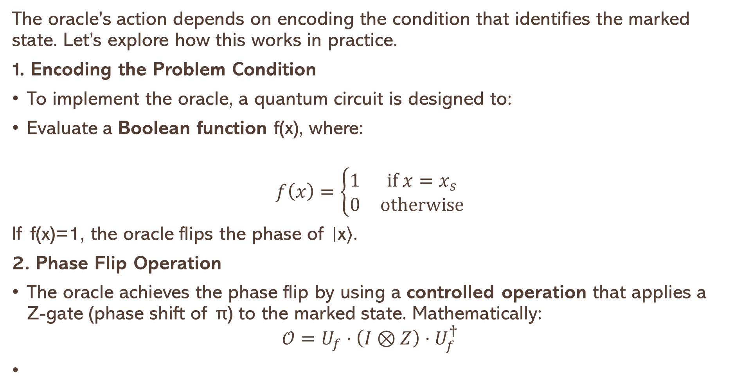
How it Works:
The oracle's action depends on encoding the condition that identifies the marked state. Let’s explore how this works in practice.
1. Encoding the Problem Condition
To implement the oracle, a quantum circuit is designed to:
Evaluate a Boolean function f(x), where:
$$f\left(x\right)=\left\{\begin{matrix}1 & if x=x_{s} \\ 0 & otherwise\end{matrix}\right.$$
If f(x)=1, the oracle flips the phase of ∣x⟩.
2. Phase Flip Operation
The oracle achieves the phase flip by using a controlled operation that applies a Z-gate (phase shift of π) to the marked state. Mathematically:
$$𝒪=U_{f}⋅\left(I⊗Z\right)⋅U_{f}^{†}$$

Slide 11
Use of the Oracle in Search
THE Objective HERE IS : Find the marked state ∣xs​⟩ from a database of N items.
Implementation Steps:
Use auxiliary qubits to evaluate f(x).
Apply a controlled-Z gate to flip the phase of ∣x⟩ if f(x)=1.
Clean up auxiliary qubits to restore the quantum state.

Slide 12
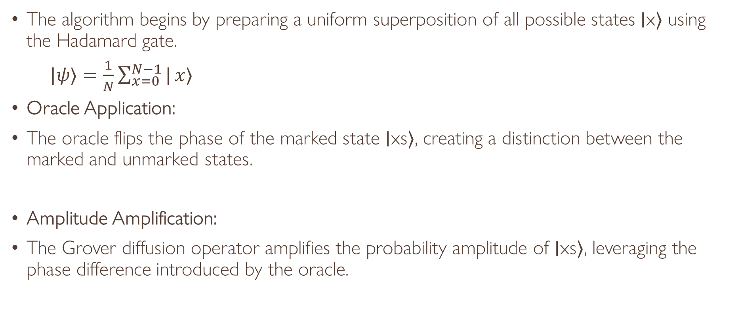
How the Oracle fits in the Solution
The algorithm begins by preparing a uniform superposition of all possible states ∣x⟩ using the Hadamard gate.
$|ψ⟩=\frac{1}{N}\sum_{x=0}^{N−1}{|}x⟩$
Oracle Application:
The oracle flips the phase of the marked state ∣xs⟩, creating a distinction between the marked and unmarked states.
Amplitude Amplification:
The Grover diffusion operator amplifies the probability amplitude of ∣xs​⟩, leveraging the phase difference introduced by the oracle.

Slide 13
Amplitude Amplification
In Grover’s algorithm, the objective is to find a specific marked state ∣xs⟩ among N possible states.
The challenge lies in the fact that a classical search would take O(N) steps, but Grover’s algorithm uses quantum mechanics to solve the problem in sqrt(O(N​)) time.
Amplitude amplification is the core process that amplifies the amplitude of the marked state and suppresses others, thus making the marked state more likely to be measured. The process consists of two key operations:
Oracle Application: Marks the correct solution by flipping the sign (phase flip) of the marked state’s amplitude.
Grover Diffusion Operator: Reflects the quantum state around the average amplitude of all states, enhancing the amplitude of the marked state.
Each iteration of applying the oracle and diffusion operator boosts the probability of finding the marked state by increasing its amplitude relative to the other states.

Slide 14
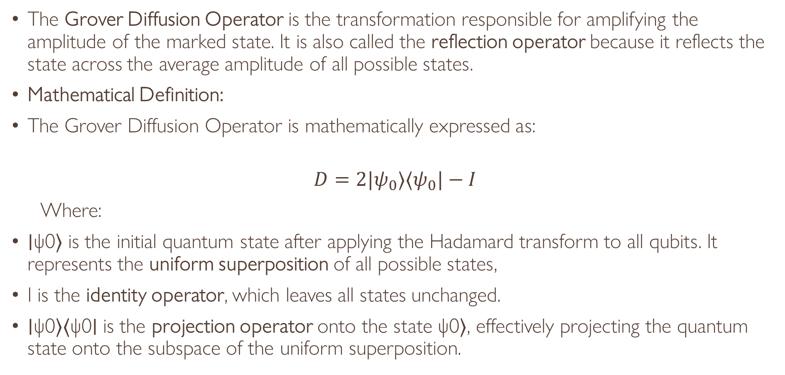
The Diffusion Operator
The Grover Diffusion Operator is the transformation responsible for amplifying the amplitude of the marked state. It is also called the reflection operator because it reflects the state across the average amplitude of all possible states.
Mathematical Definition:
The Grover Diffusion Operator is mathematically expressed as:
$$D=2|ψ_{0}⟩⟨ψ_{0}|−I$$
Where:
∣ψ0​⟩ is the initial quantum state after applying the Hadamard transform to all qubits. It represents the uniform superposition of all possible states,
I is the identity operator, which leaves all states unchanged.
∣ψ0​⟩⟨ψ0​∣ is the projection operator onto the state ψ0​⟩, effectively projecting the quantum state onto the subspace of the uniform superposition.

Slide 15
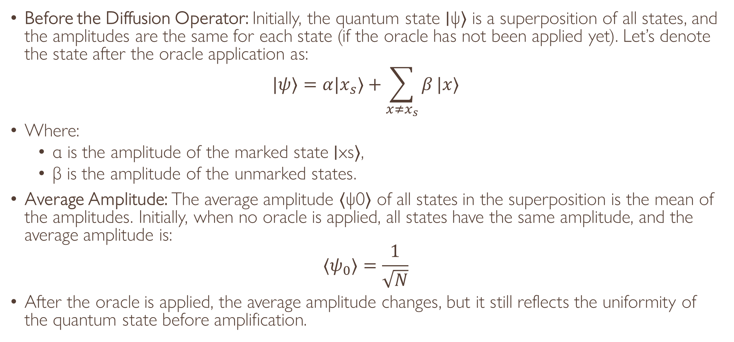
Step-by-Step Reflection
Before the Diffusion Operator: Initially, the quantum state ∣ψ⟩ is a superposition of all states, and the amplitudes are the same for each state (if the oracle has not been applied yet). Let’s denote the state after the oracle application as:
$$|ψ⟩=α|x_{s}⟩+\sum_{x≠x_{s}}{β}|x⟩$$
Where:
α is the amplitude of the marked state ∣xs​⟩,
β is the amplitude of the unmarked states.
Average Amplitude: The average amplitude ⟨ψ0​⟩ of all states in the superposition is the mean of the amplitudes. Initially, when no oracle is applied, all states have the same amplitude, and the average amplitude is:
$$⟨ψ_{0}⟩=\frac{1}{\sqrt{N}}$$
After the oracle is applied, the average amplitude changes, but it still reflects the uniformity of the quantum state before amplification.

Slide 16
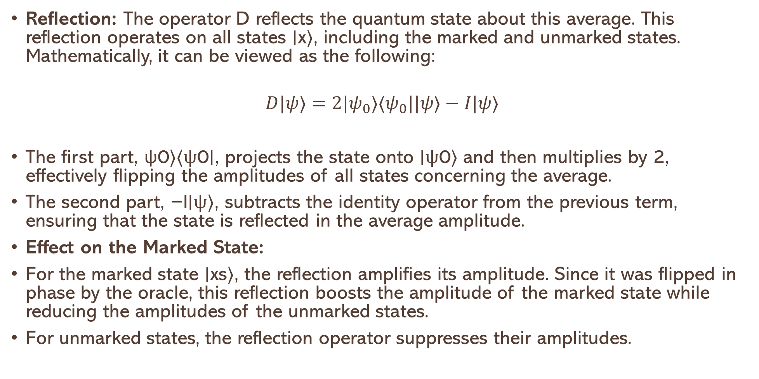
Reflection
Reflection: The operator D reflects the quantum state about this average. This reflection operates on all states ∣x⟩, including the marked and unmarked states. Mathematically, it can be viewed as the following:
$$D|ψ⟩=2|ψ_{0}⟩⟨ψ_{0}||ψ⟩−I|ψ⟩$$
The first part, ψ0​⟩⟨ψ0​∣, projects the state onto ∣ψ0​⟩ and then multiplies by 2, effectively flipping the amplitudes of all states concerning the average.
The second part, −I∣ψ⟩, subtracts the identity operator from the previous term, ensuring that the state is reflected in the average amplitude.
Effect on the Marked State:
For the marked state ∣xs​⟩, the reflection amplifies its amplitude. Since it was flipped in phase by the oracle, this reflection boosts the amplitude of the marked state while reducing the amplitudes of the unmarked states.
For unmarked states, the reflection operator suppresses their amplitudes.

Slide 17
Why Amplitude Amplification
The core reason amplitude amplification works is based on the principles of quantum interference.
The oracle creates a phase shift that discriminates the marked state from the others.
The diffusion operator then reinforces this difference by amplifying the marked state’s amplitude through constructive interference, while suppressing the unmarked states via destructive interference.
This constructive interference for the marked state and destructive interference for the unmarked states results in an exponential increase in the probability of measuring the correct state after several iterations.

